Slide 1
Amalio Nieves
Boston Public Schools

Slide 2
How Can Schools Be More Human?
BOSTON PUBLIC SCHOOLS
Amalio Nieves, Assistant Superintendent
Office of Social Emotional Learning & Wellness
GradNation Summit
October 14, 2016
2
Notes:
In the 21st century, students' character, social-emotional skills, and academic competencies will define school excellence.
Recent research in emotional intelligence, brain-friendly learning, and social-emotional influences on learning and performance has shown that social and emotional competencies are an integral part of academic success (Collaborative for Academic, Social, and Emotional Learning [CASEL], 2003). The conceptualization of the EQ + IQ connection makes clear that the organizational climate influenced by educational leaders is a necessary condition for that success. When students are given systematic, evidence-based opportunities to build their social-emotional learning (SEL) skills, a more positive environment for learning is created and schools become more human. There is a concern not only for safety and freedom from violence, but also with the exercise of positive character in how students treat one another, staff members treat one another, arid staff members and students treat one another. So how do schools become more human?

Slide 3
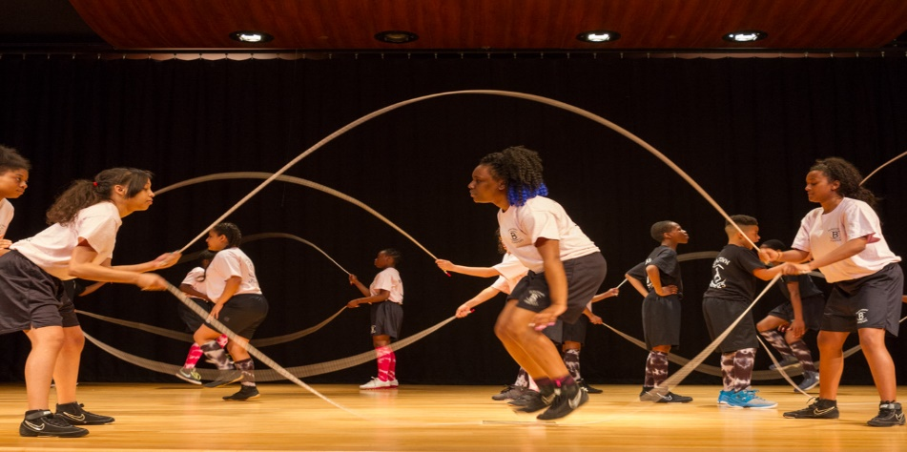
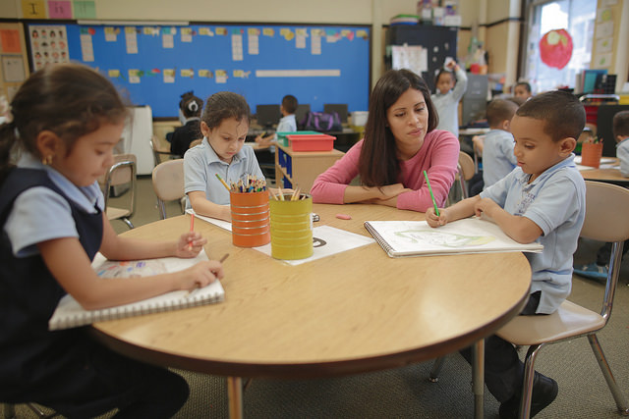
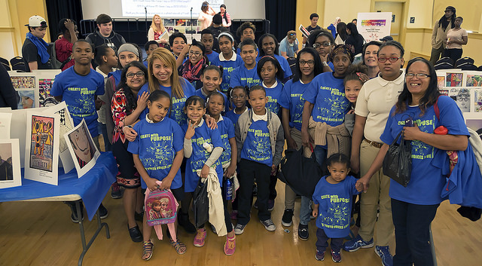
BOSTON PUBLIC SCHOOLS
BOSTON PUBLIC SCHOOLS
The Why….
3
Notes:
Many times in our lives, we are dropped, crumpled, and ground into the dirt by some people in our lives and the circumstances that come our way. We are made to feel as though we are worthless; but no matter what happened or what will happen, you will never lose your value.
How do we ensure as we strive for schools to be human, that we ensure learning is seen as a partnership and a mutuality, rather than a highly competitive activity with a small number of clear winners and a vast number of losers?
How can we play a role in ensuring that schools become more human, that SEL competencies are valued as the keys that unlock the doors of opportunity and illuminate pathways of accomplishment? And as schools become more human and opportunity replaces discouragement, can we in turn ensure learning becomes more valued by more students, which then, leads to more risk reduction, asset building, and greater attachment and engagement in school?
3

Slide 4
BOSTON PUBLIC SCHOOLS
BOSTON PUBLIC SCHOOLS
BPS Strategic Implementation Plan Stronger Schools; Stronger Boston: A Plan to Foster Equity, Coherence and Innovation
Focus Area 1: Academics
Implement an inclusive, rigorous, and culturally/linguistically sustaining PK-12 instructional program that serves the development of the whole child.
EQ + IQ = Best Educational Practices for Caring and Supportive Schools
4
Notes:
All children have certain developmental rights to grow up knowledgeable, responsible, nonviolent, drug free, and caring; to acquire the inclination and skills to be productive contributors to their schools, families, workplaces, and communities; and to take on the responsibilities of being participatory citizens of a democracy.
The issue should not be framed as a choice between intellectual versus social development or academic versus inter- and intrapersonal skills, but a both-and reality.
4

Slide 5
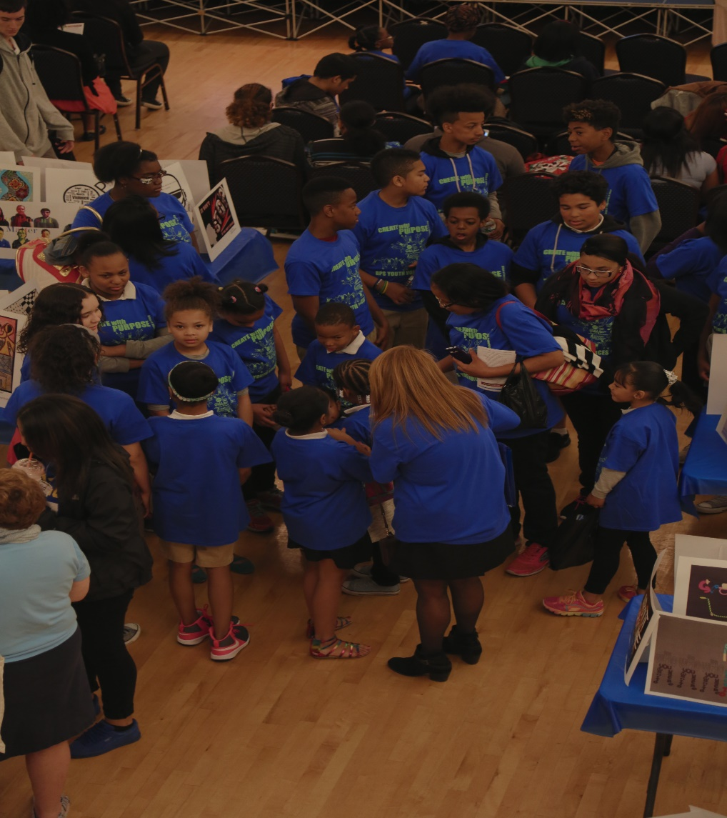
BOSTON PUBLIC SCHOOLS
BOSTON PUBLIC SCHOOLS
What does BPS mean by “whole child?”
BPS’ whole child approach to education is defined by policies, practices, and relationships in school environments that ensure ALL students, ALL families and ALL staff, in all schools are safe, healthy, welcomed, engaged, supported, and challenged.
5
Notes:
Note that our emphasis is not on some, but all students, all families, all staff, in all schools
Also, note the emphasis on practices and relationships:
In schools that are more human, schools are focused not on preparing students for a life of tests, but rather preparing young people for the tests of life. Educators who understand this accept and integrate data from brain-based research showing the essential role of emotions in learning and that the soul and spirit of children is not a touchy-feely irrelevancy to the instructional process.
5

Slide 6
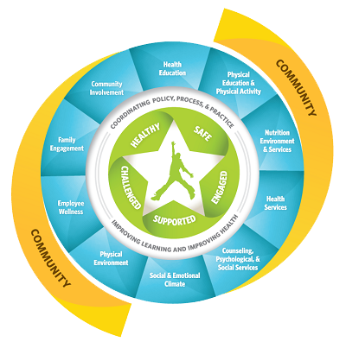
BOSTON PUBLIC SCHOOLS
BOSTON PUBLIC SCHOOLS
Whole School, Whole Community, Whole Child
HUMAN
6
Notes:
Sound classroom structure and function are based on a foundation of caring relationships and that such relationships are nurtured among all school staff members, students, and parents (Blankstein, 2003). The foundation is set amid a school culture that values and respects children. Comer (2003) has said that children do not learn character as much as they "catch" it from the adults around them and the way adults set up experiences for them and interact with them. Therefore, it becomes vital for students to have a stake in their learning outside traditional academic disciplines. Model schools of sound character and academic excellence are filled with a comprehensive and interconnected array of challenging and motivating programs and activities which help students recognize that they have a vital stake in their learning and that they are among the decision makers in their school.
It is also important to embrace the new pedagogy supported by brain research. Students function better and learn more effectively when they are encouraged to have clear, positive goals and values; when they are able to manage their emotions and make responsible decisions; and when they engage in setting goals for their own learning while also pursuing the academic goals that must be reached to function well in society. Giving students opportunities to help direct their learning and to make decisions about their own education and the climate and programs of the school reflect a school culture of caring, respect, responsibility, and achievement. When principals and staff members are willing to see through the eyes of students and to kindle students' spirit and joy as part of the learning environment, they are moved to create instructional programs that encourage them to make connections and create meaning through reality-based and project-based activities. School leaders now see that their buildings can be more human, renewing, exciting places for both students and adults. Visionary leaders recognize the roles of teachers, parents, and community stakeholders in making schools current and meaningful. They understand that the opportunities for a child to be guided in his or her actions by ethical sensitivity and to reach social, emotional, and academic goals are enhanced to the extent to which the school, parents, and community collaborate. Collectively, they model caring and moral behavior. The guidance offices, medical office, and main office are hubs of activity where caring staff members and students interact for everyone's well-being. These are not places where people mainly go when they are "sent." Administrators, teachers, and other education support staff members trust and respect students and exude boundless optimism. In such a human environment, the classrooms, schools, and communities are safe havens for students and nonthreatening sources of partnership for parents. Even the principal's office is a welcoming place for all.
6

Slide 7
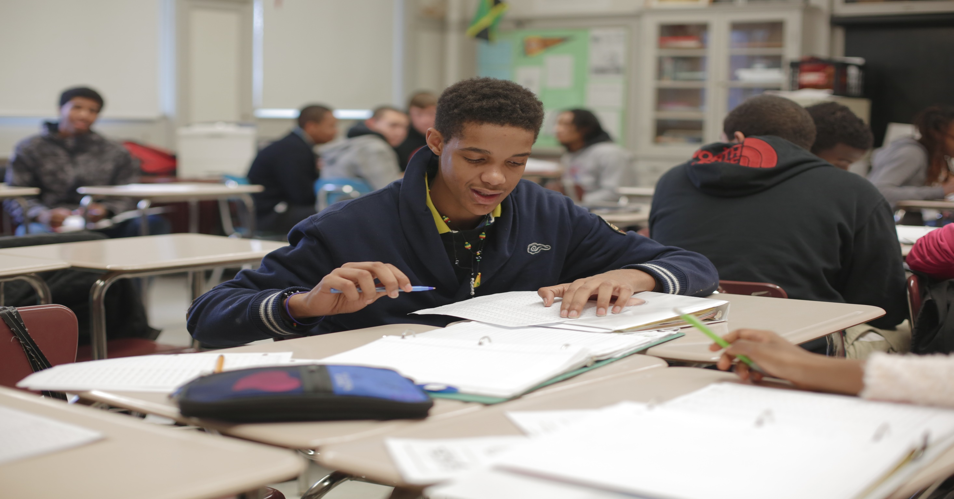
MAKING SCHOOLS MORE HUMAN
BOSTON PUBLIC
BOSTON PUBLIC SCHOOLS
CLOSER LEARNING RELATION-
SHIPS
BASIC NUTRITIONAL, FITNESS, & HEALTH NEEDS
RESPECT & VALUE PARENTS
VALUE & NURTURE STAFF MEMBERS
PROVIDE
GOAL-SETTING
DECISION-MAKING
PROBLEM-SOLVING OPPORTUNITIES
BUILD
EMPATHY
AUTHENTIC CONTEXTS FOR MORAL ACTION
7
Notes:
1. Empathy is one of the most essential, but oftentimes neglected, attributes of students today (Elias, Arnold, et al., 2003). As Comer (2003) implied about character, school leaders recognize that empathy is not best conveyed through formal instruction. Rather, empathy is best developed in a context of social responsibility (Berman, 1998).Student involvement in setting goals and making responsible decisions for their own learning extends beyond academic and cocurricular programs because involvement goes beyond self. Students behave more responsibly and respectfully when given opportunities for moral action and community service.
2. In schools in which EQ+ IQ share priority, students are responsible for setting personal goals and working to achieve them at their own pace. They play a role in initiating and organizing comprehensive and inclusive cocurricular programs in which every student is encouraged to participate, and in turn every student is valued, respected, and encouraged. Students design peer-mentoring programs within or between schools (e.g., a student-directed program to facilitate the transition from middle school to high school). Every school activity and event can become an opportunity to learn and to share one's learning with others.
3. Students also respond well to authentic contexts in which to take deeply moral action. Visionary leaders are not afraid to depart from the standard curriculum to respond to local, regional, national, and international events of great significance. Following the tragic events of September 11, 2001, students across the nation demonstrated their concern for the victims through a variety of humanitarian efforts. In some schools, these activities were carried out at a deeper level, extending for a long period of time and becoming integrated into the fabric of learning. Visionary leaders see, in these situations, the opportunity to deeply affect students with the power they have to take moral action.
4. To create structures in which to nurture caring relationships, many schools are organized into smaller units (e.g., houses and teams) that enhance curriculum coordination among academic subjects and provide a supportive environment for students. This kind of organization enables teachers to work more directly with fewer students, to determine more easily their strengths and needs, and to design effective, individualized strategies (Pasi, 2001). In addition, schools often address the special needs of students through a collaborative model in which full-time special needs teachers are assigned to teams of regular education teachers; all of them work together seamlessly for the well-being of all students.
5. Basic Nutritional, Fitness, and Health Needs
6. Leaders of schools with EQ + IQ success recognize the vital role that teachers play in the school culture and acknowledge the contributions they make to the social-emotional well being and academic success of students. One important manifestation of this understanding is when principals visibly recognize the accomplishments, strengths, and needs of their staff members. Celebrations and other forms of recognition are common in schools with visionary leadership. Valuing and nurturing staff members enhances the culture of the school.
7. When schools view sound character and deep learning as a unit, educational leaders invite parents to meet regularly. However, "invite" is misleading. The true intent is to drag in as many parents as possible, especially those who do not typically attend when invitations are made. The goal is not to show how open the school is, but rather to open the school successfully. Therefore, creative means are used to bring people in, such as having other parents, staff members, and even students do the inviting, as well as principals asking directly. Furthermore, meetings outside the school are encouraged, as are approaches to reach out to parents through digital broadcast and print media. Similarly, parents are valued, respected, and welcomed into the school community. They are vital contributors and participants. Some schools establish parent centers, which serve as the parents' home in the school. Such centers nurture a sense of belonging to the school culture and reflect a commitment to the important role parents and families play in the life of the school. In partnership with the school, parents plan schoolwide events. They join the school staff members in modeling respect, caring, and responsibility.
7

Slide 8
BOSTON PUBLIC SCHOOLS
BOSTON PUBLIC SCHOOLS
Back to the Why….
8
Notes:
Visionary school leaders in the 21st century will see that high stakes in schools are not about test scores but about the souls and character of students and what they will do with what they have learned. The greatest threat to communities, culture, and civilization is not poison from the outside but poison from the inside. If the fundamental shared vision is that of caring for children, then their academic skill development follows without question. But academic skill development cannot exist as a sole value, or even predominate. It is part of a balance, the balance that is essential to healthy human functioning not only in students but also in the teachers, parents, and stakeholders who work to socialize them. This may not be the most popular vision, or the easiest to share and implement, but it is the vision needed by current and future educational leaders. Ultimately, it is a profoundly meaningful and practical approach that serves as the basis for the academic success of students and a force for nurturing and unifying all members of a school community
Dirty or clean, crumpled or finely creased, you and all of our students are still priceless to those who love you and them. The worth of our lives comes, not in what we do or who we know, but by …WHO WE ARE. WE are ALWAYS special, don't ever forget it
8

